Slide 2
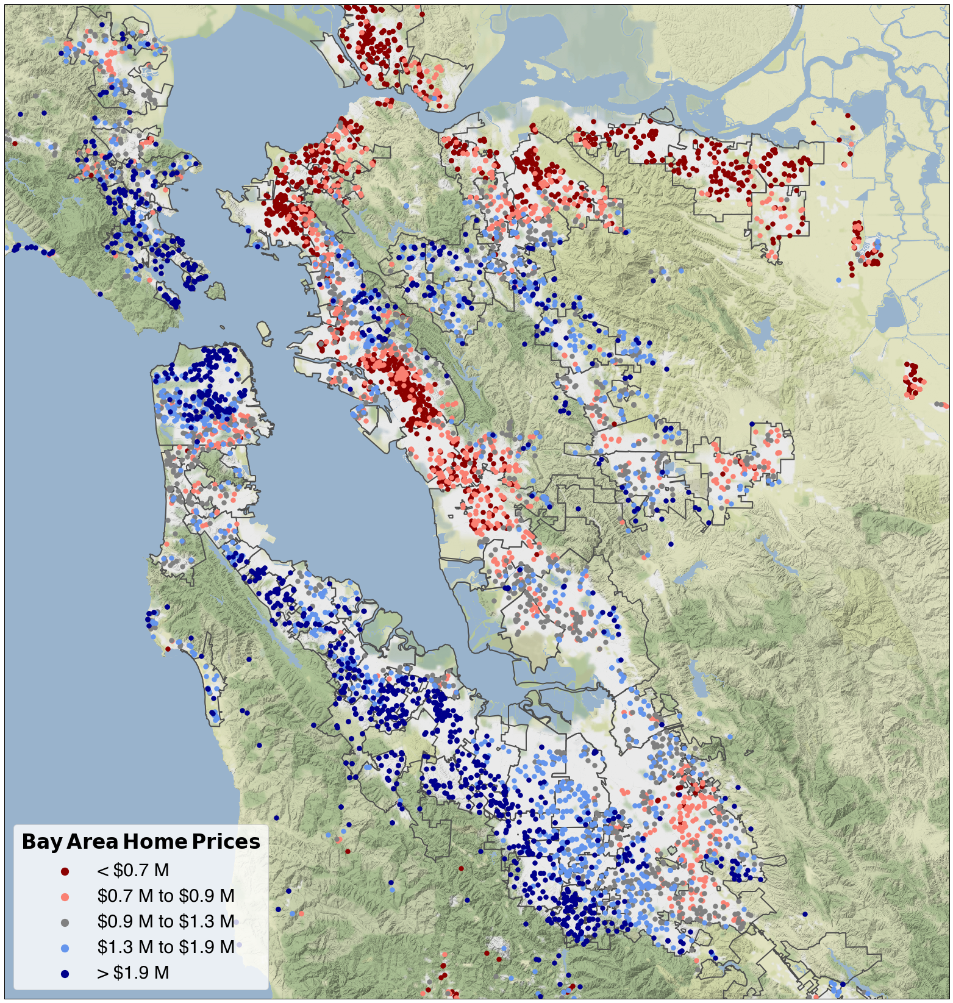
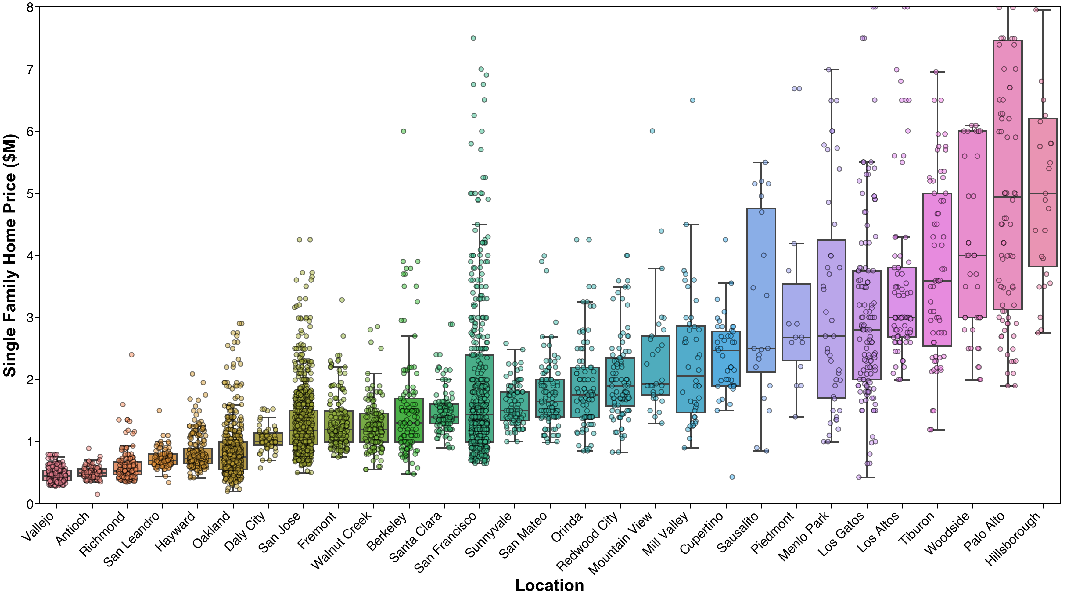
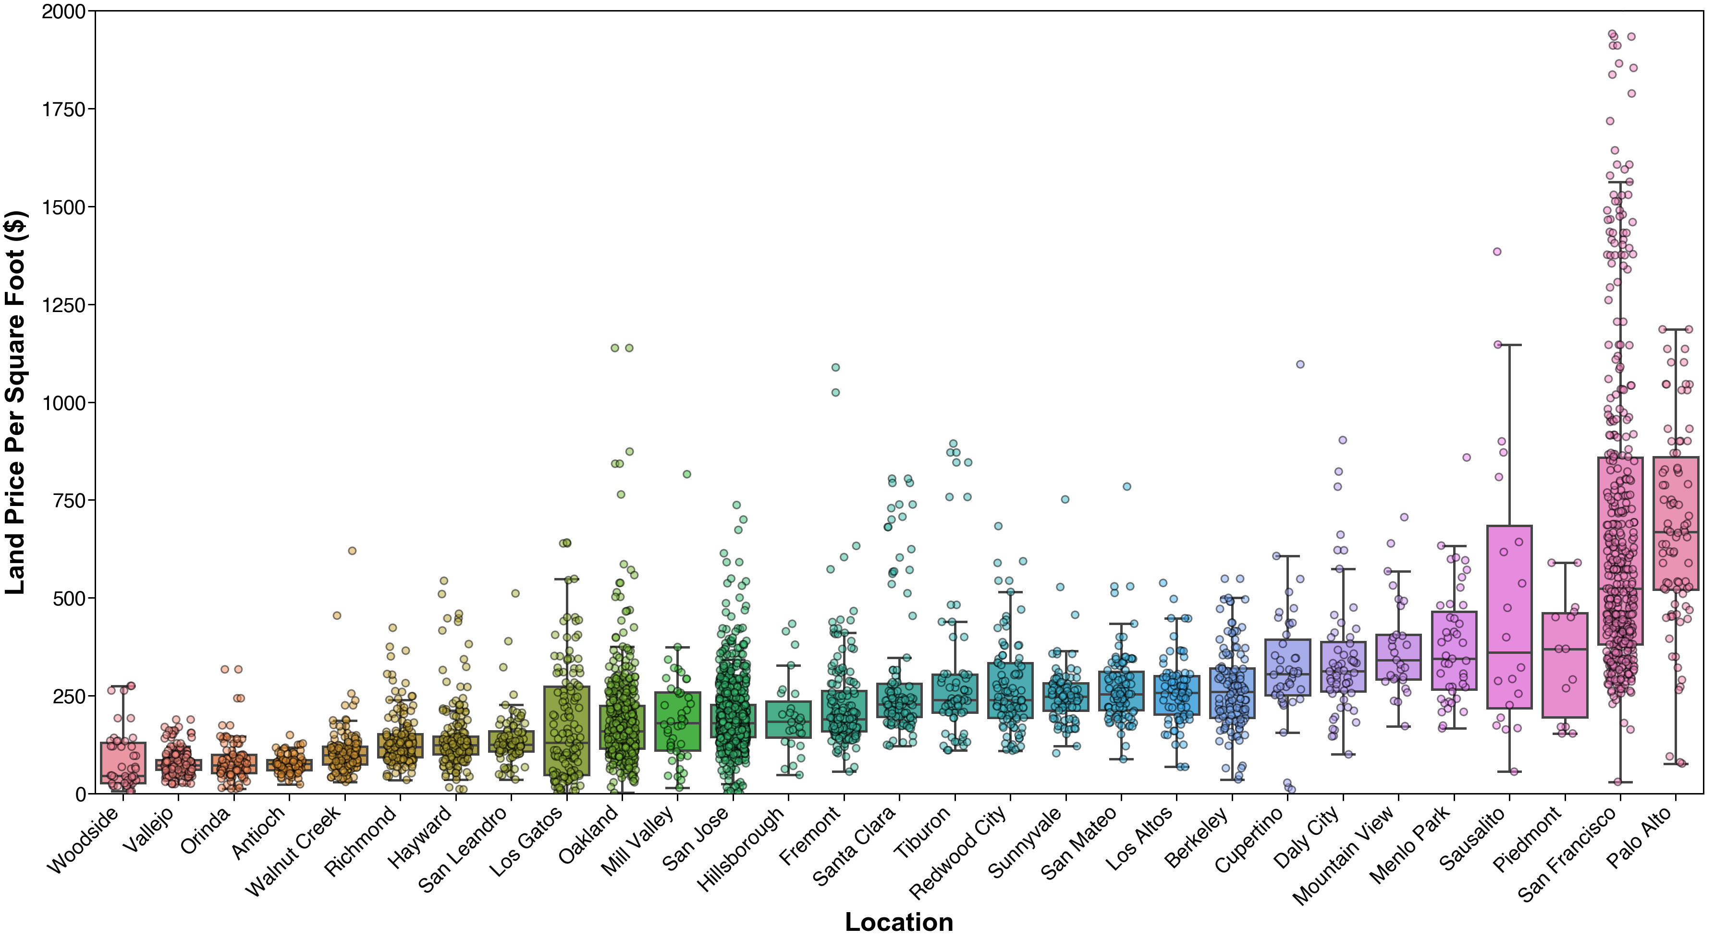
Vallejo
Antioch
Richmond
Walnut Creek
Berkeley
Orinda
Oakland
San Francisco
San Leandro
Daly City
Hayward
San Mateo
Redwood City
Menlo Park
Fremont
Woodside
Palo Alto
Mountain View
San Jose

